Slide 1

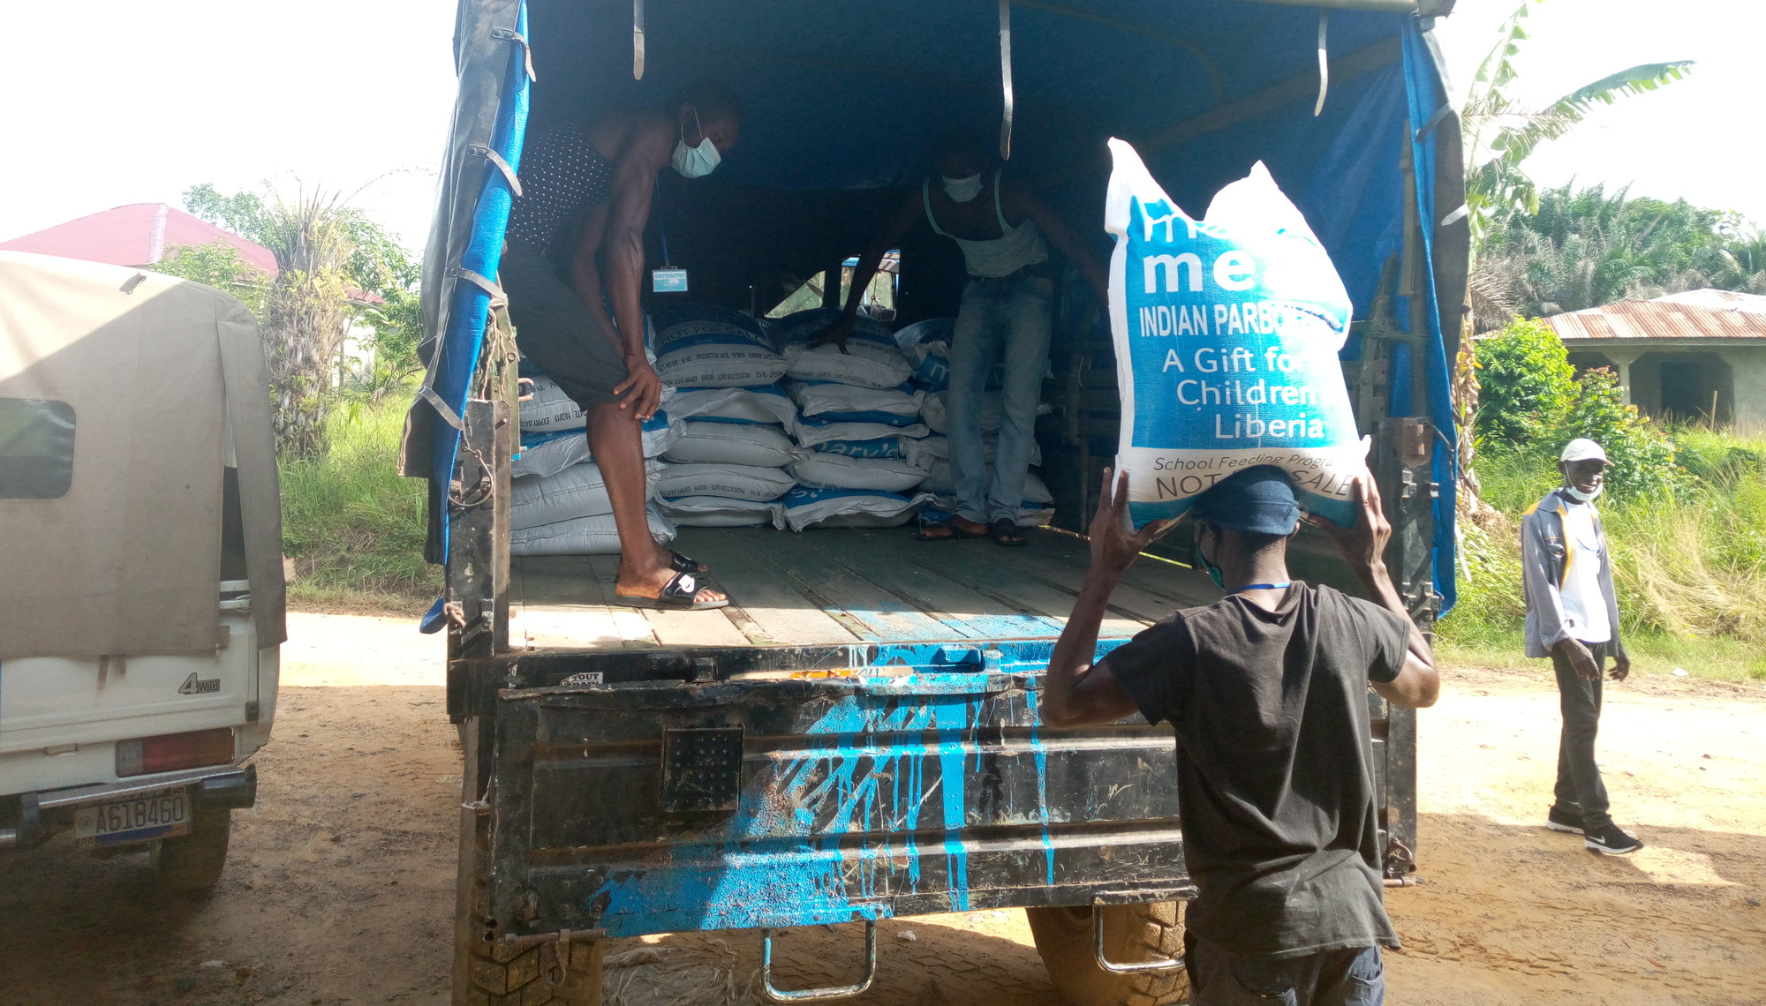
Sponsor A School Update
Cradle Kids Primary School, Liberia
Current School Enrolment: 237
Sponsored By: Osterkerzenaktion Mettingen (Claudia Keller)

Slide 2


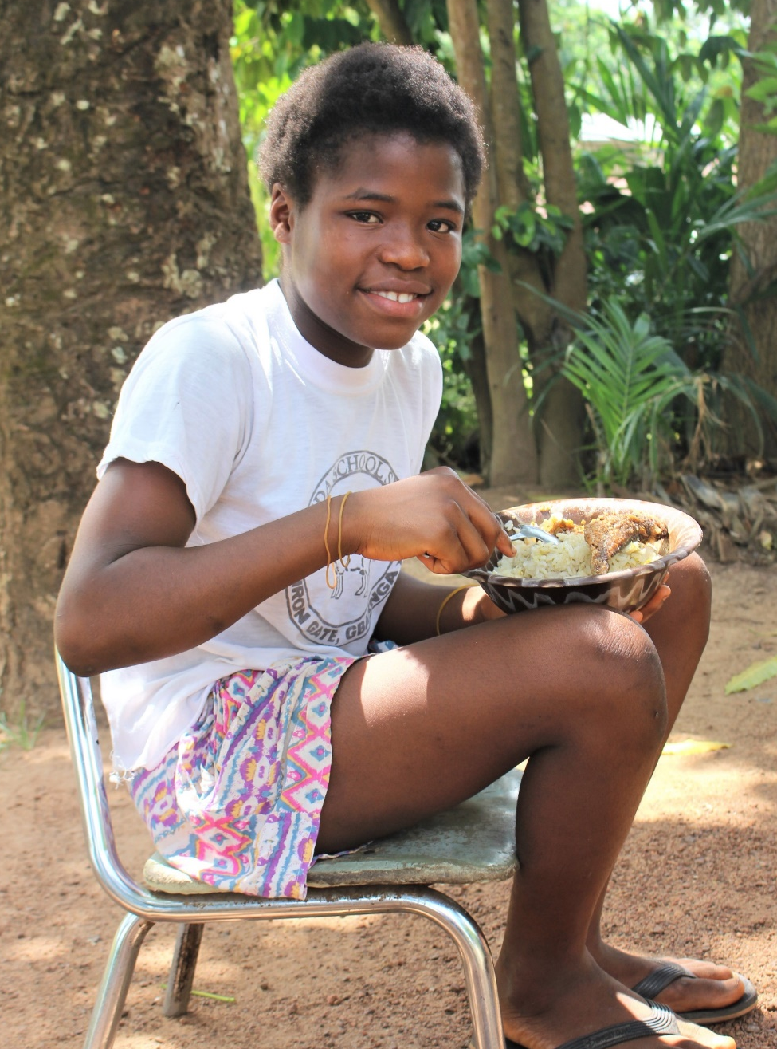
Thank you for changing lives!
You’re doing something amazing! By sponsoring a school, you’re giving children in one of Liberia’s poorest communities the chance to gain a life-changing education.
With the spread of Covid-19 and resulting disruption and restrictions, unfortunately we are unable to provide you with a detailed report on your specific school for the foreseeable future.
However, we hope this more general update – with information on our Covid-19 response – demonstrates that Mary’s Meals’ work cannot and will not stop.
Thank you for helping to make this possible!

Slide 3
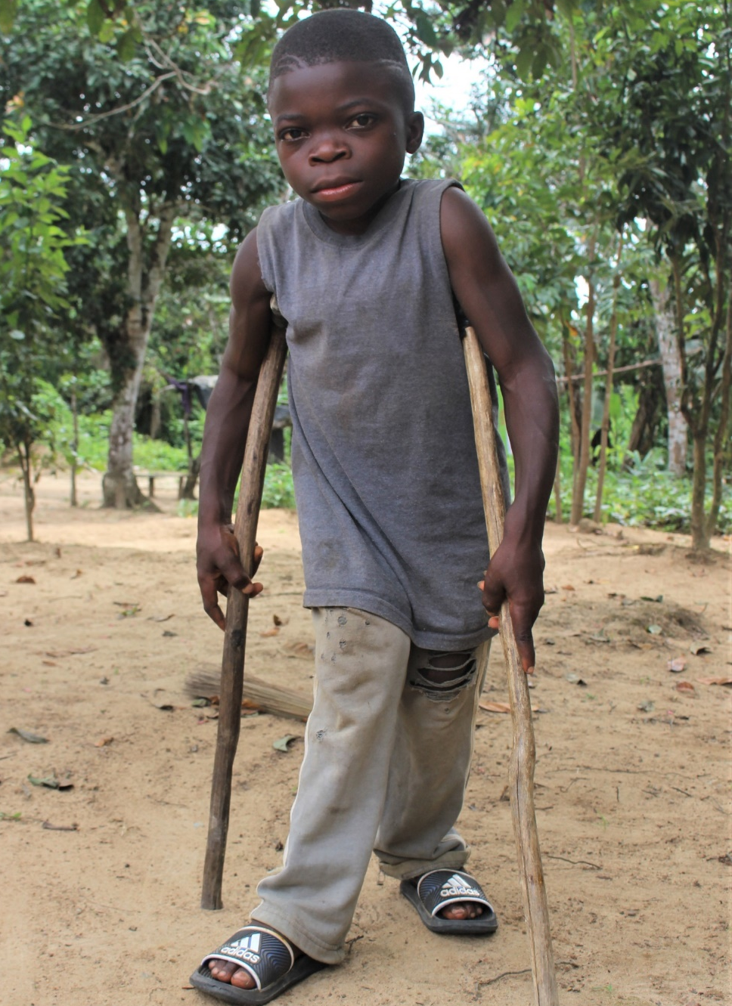
About Mary’s Meals (i)
Mary’s Meals works with local communities to provide life-changing school meals.
We run programmes in 19 countries where poverty and hunger often prevent children from gaining an education.
Our vision is that every child receives one daily meal in their place of education and that all those who have more than they need, share with those who lack even the most basic things.
Mary’s Meals offers children hope and, through education, a possible route out of poverty for the future.

Slide 4
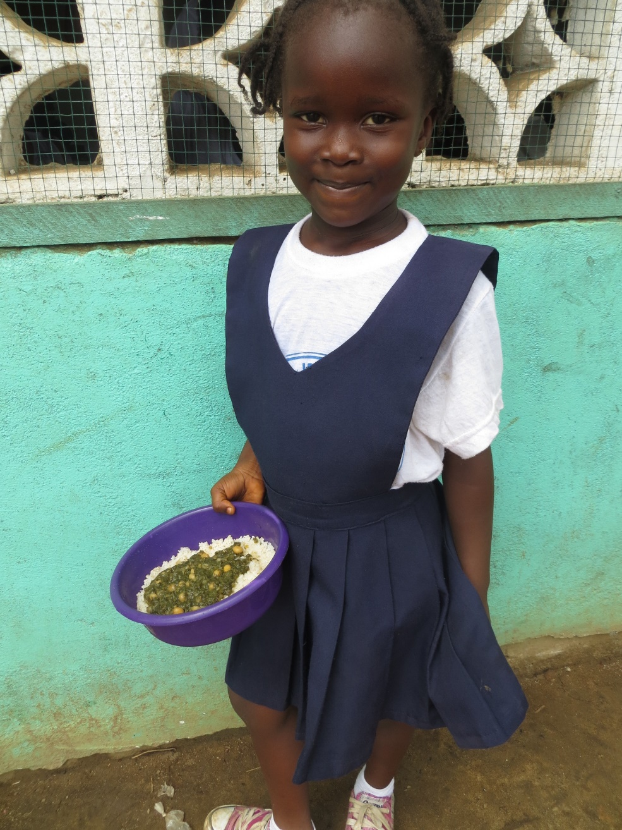
About Mary’s Meals (ii)
It costs just £15.90 / €18.30 / $21.00/ $26.40 to feed a child with Mary’s Meals for an entire school year.
It’s a simple idea that works. Research shows that children who eat Mary’s Meals:
- have more energy
- feel healthier and happier
- find it easier to concentrate and
- do better in school
We are committed to keeping costs low – at least 93% of donations are spent on our charitable work.
Without our passionate volunteers and supporters, our work would not be possible.

Slide 5
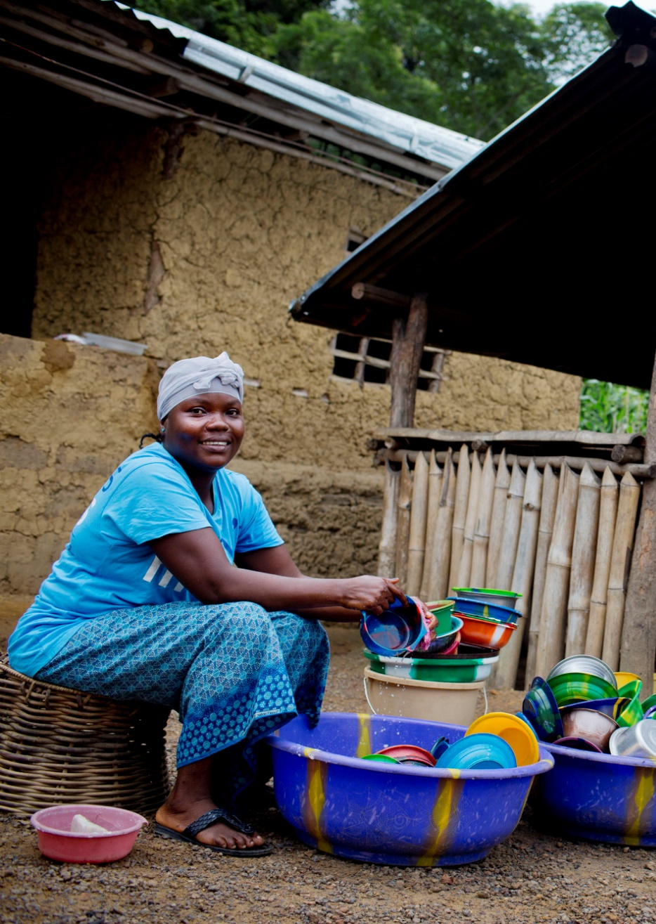
About Mary’s Meals (iii)
Mary’s Meals is owned and run by local communities.
We provide training, equipment and ingredients so that volunteers can cook and serve the school meals for the children.
While schools were closed because of the Covid-19 pandemic, we continued to keep our promise to children by distributing take-home rations to allow their parents to cook for them at home while they learned.
Where possible, we buy food from local farmers and producers, which helps to support local economies and benefits the wider community.

Slide 6
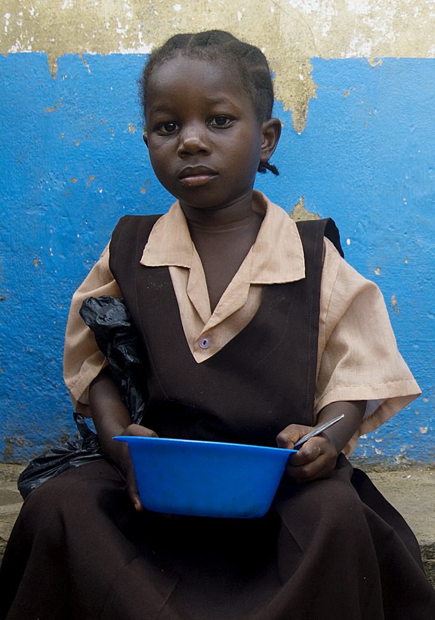
Mary’s Meals in Liberia
Nearly two thirds of Liberians live in poverty and many of the most marginalised communities don’t have electricity or running water.
Despite well over a decade of peace, the legacy of civil war still casts a shadow. Many of the schools destroyed during the fighting have yet to be rebuilt and more than 60% of children are missing out on an education.
The Ebola outbreak has also had a devastating impact. Many children lost family, and years of education, as schools closed to stop the disease from spreading.
Together, we’re bringing life-changing school meals to more than 120,000 children in Bomi, Bong, Grand Cape Mount, Gbarpolu, and Montserrado counties.

Slide 7
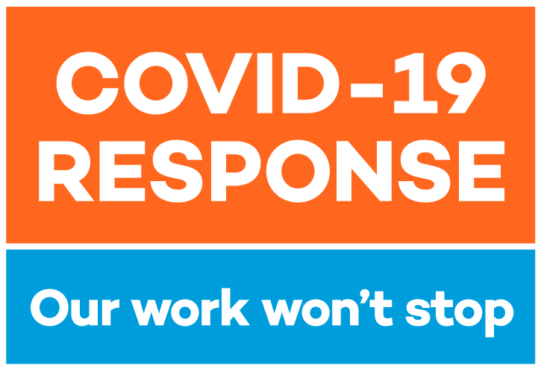
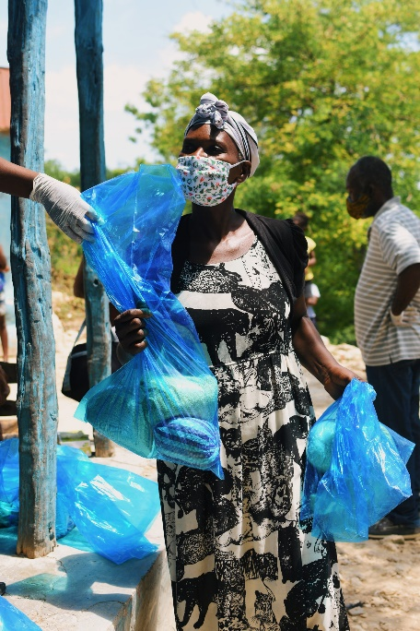
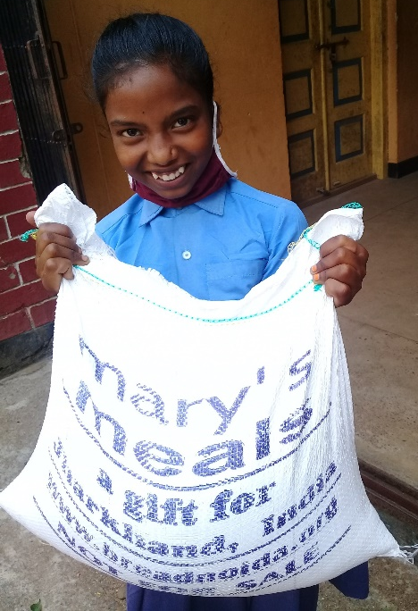
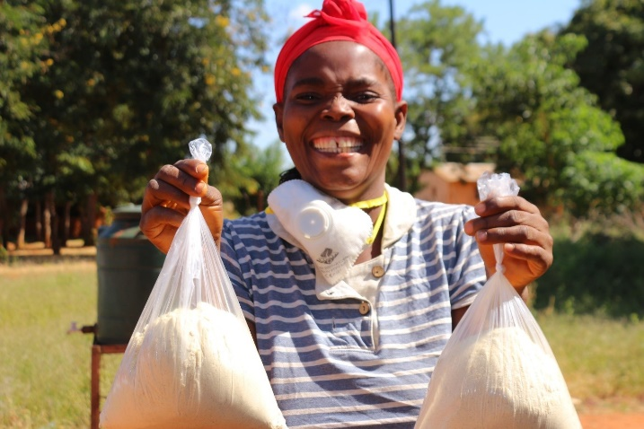
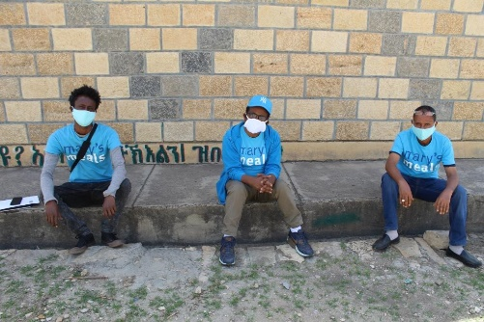
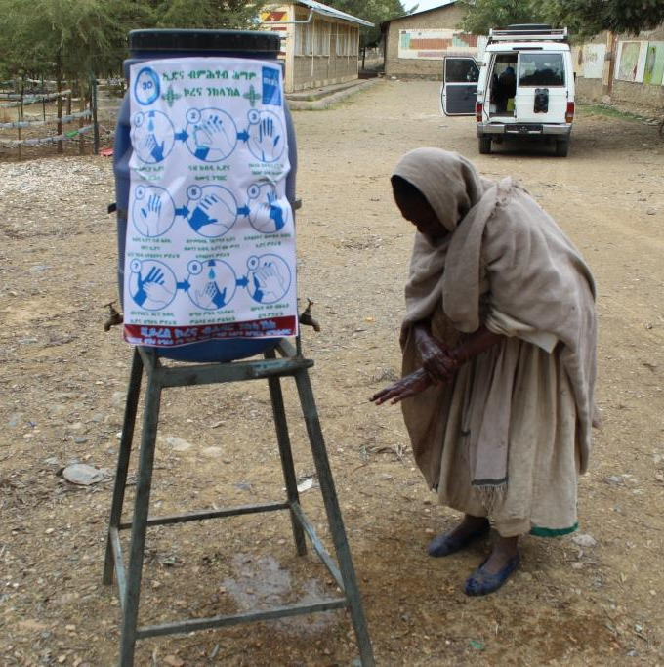
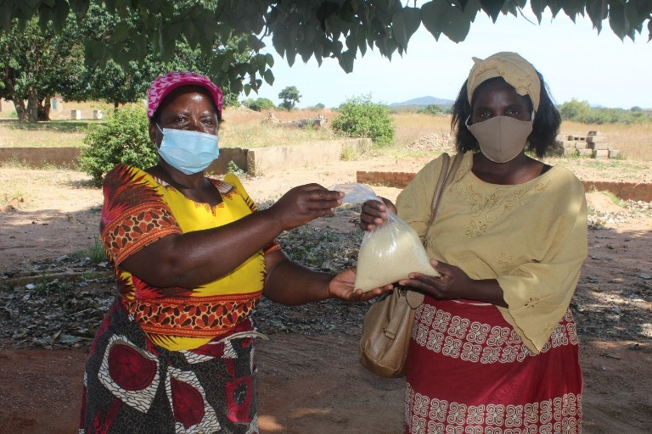
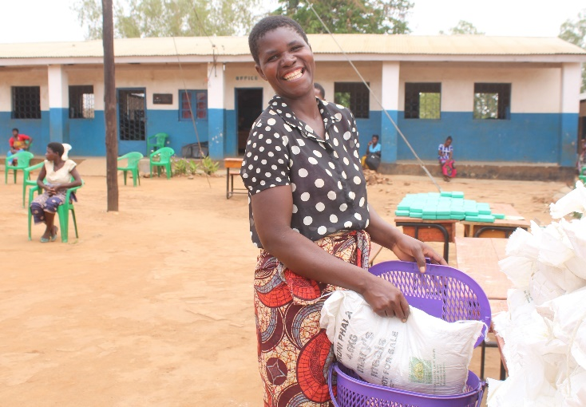
Our Covid-19 response

Slide 8
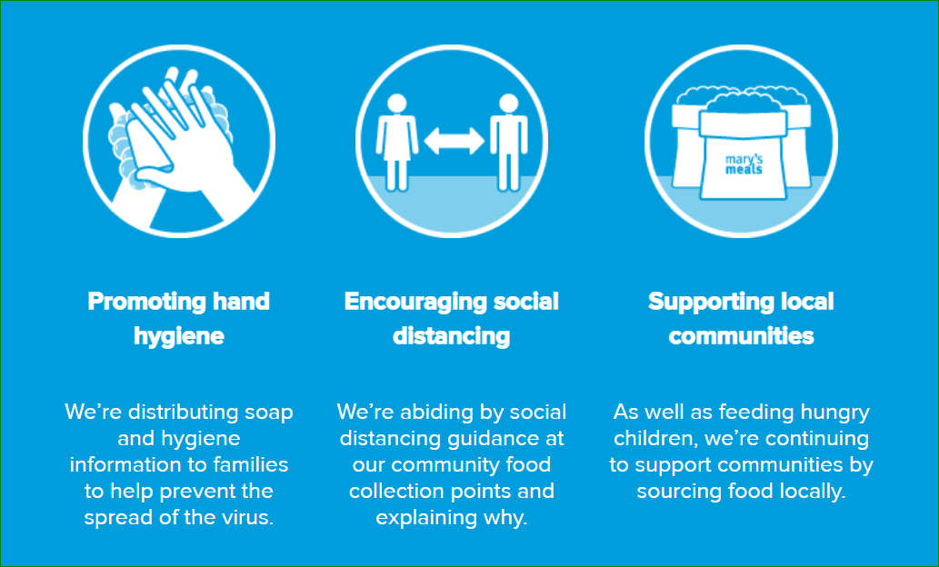
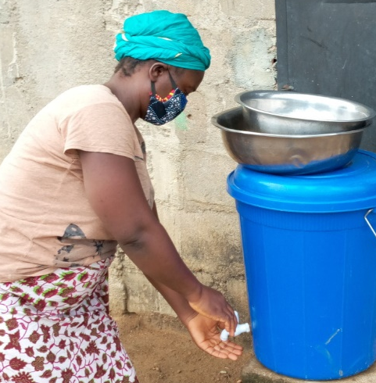
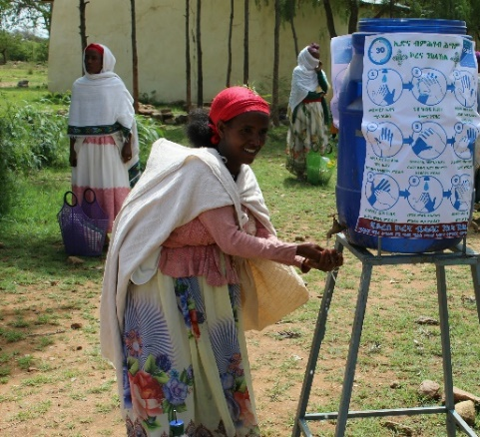
Our Covid-19 response (i)
Around the world, Covid-19 forced schools to close and homes became places of learning.
We had to find new ways of reaching the children who eat Mary’s Meals – sometimes the only food they receive in a day.
Working with governments, community
leaders and our trusted partners, we
developed new methods of distribution.
Through our Covid-19 response activities, we are still, thankfully, reaching virtually all of the children who rely on our nutritious meals. We are providing take-home rations through community distributions in countries where schools are closed and conducting in-school feeding where it is safe to do so.

Slide 9
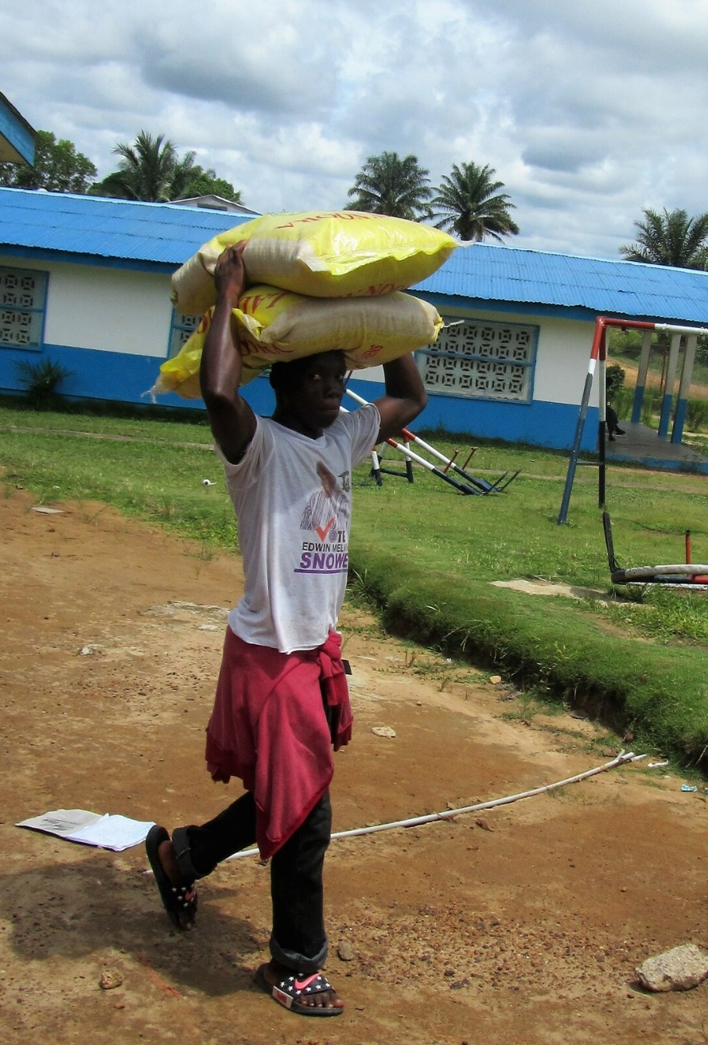
Our Covid-19 response (ii)
In Liberia, schools began to reopen at the beginning of 2021 and in-school feeding has resumed with necessary safety measures in place.
While schools were closed, parents collected take-home rations from a central distribution point and cooked daily meals for their children who were learning at home.
Things are changing from day to day and we are working closely with schools, communities and governments to monitor the situation and ensure that we are delivering meals in the safest way possible.

Slide 10
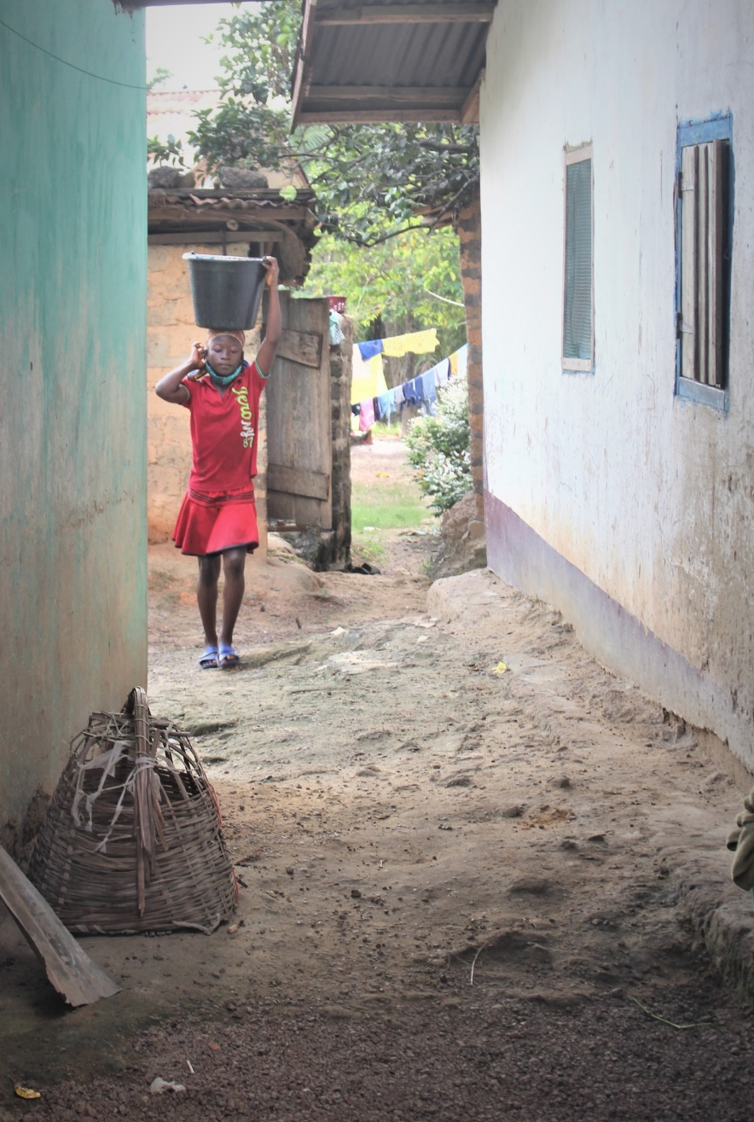
Case study, Liberia: Success Darwolo
Success is a quiet and serious 12-year-old who lives with her parents, her younger sister, her aunt and her two cousins in Far East Community, Gbarnga.
Her father works in the laboratory at a nearby hospital and her mother sells plantain chips and sachets of water locally. As their eldest child, Success is dedicated to doing chores before school.
She walks to school with her sister and the rice and beans they receive during morning break is always their first meal of the day.
When schools closed and food prices increased, her mother Teta was very thankful for the take-home rations provided by Mary’s Meals. She said: “We cannot find the money every day to buy food, so it helped. The children like beans; when we’re cooking them, everyone can be happy!”

Slide 11
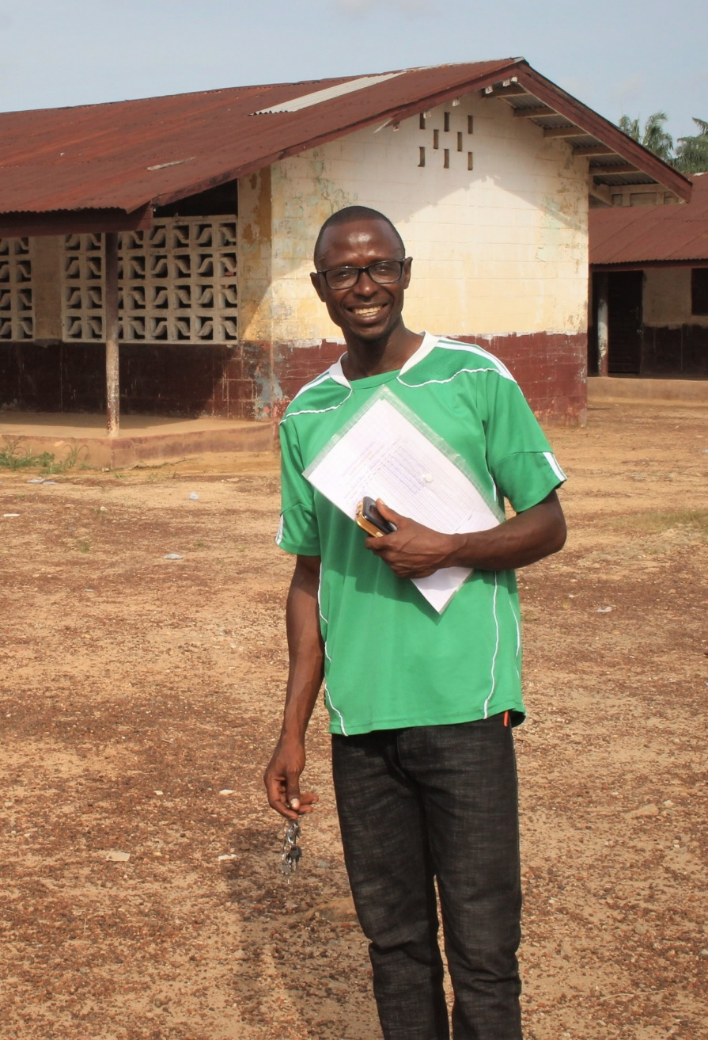
Case study, Liberia: Amos Jusu, School Principal
The school Amos is principal of joined the Mary’s Meals programme in September 2019. He remembers how difficult it was to keep children in school when there was no food.
He told us: “Before, enrolment was low. After recess the children would go home or go looking for fruits to pick. By the end of the school year classrooms would be empty. As the principal I was embarrassed. We asked students who never used to come to school, what was the reason. And the only reason was hunger.
“We thank Mary’s Meals so much. We are relieved. Students who were not coming to school come on campus and remain learning. We really appreciate this programme. All of us now plan our lessons and teach throughout the day with students in class. When they eat and they know they will eat tomorrow they will come to school.”

Slide 12
Thank you!
One of the core values of Mary’s Meals is that we believe in the innate goodness of people.
In this time of crisis, we are seeing this goodness every day from all corners of the Mary’s Meals family.
We are so grateful to all our volunteers and supporters for keeping their faith in our mission for the sake of the children and families who rely on Mary’s Meals.
Thank you for the crucial role you are playing in bringing food and hope to thousands of children.
For the latest updates about our Covid-19 response, visit our website: marysmeals.org or social media channels.

Slide 13
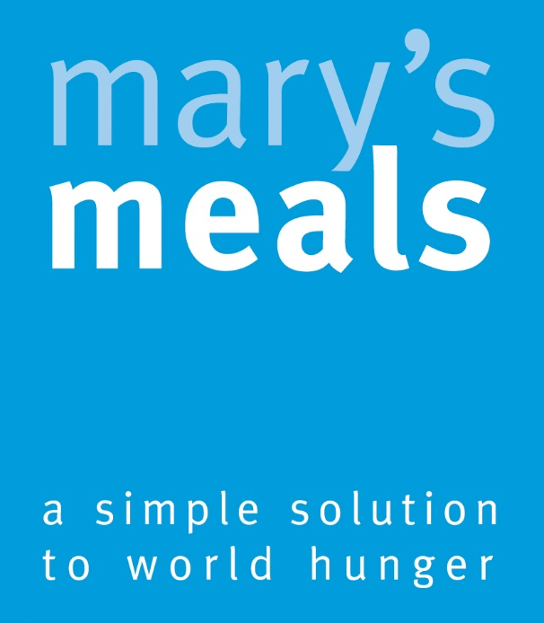
To find out more about Mary’s Meals or to contact our team, please visit:
marysmeals.org

